Slide 1
Weekly Report 06/30
Data Exploration & Descriptive Analysis
Stella Yunge Li
Nan Yin

Slide 2
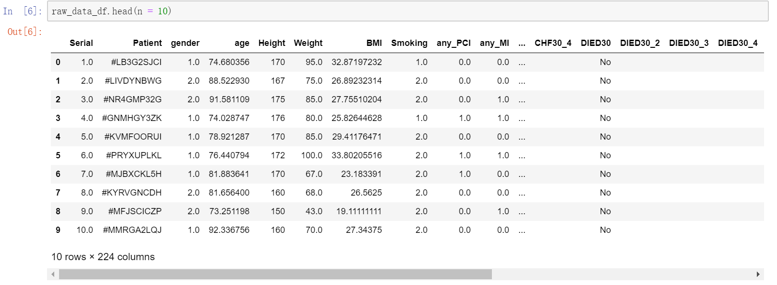
Load the Raw Data

Slide 3
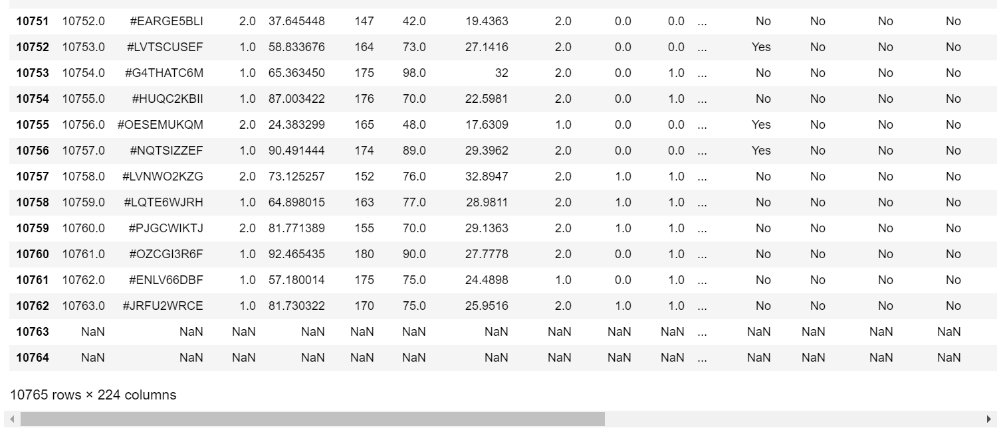
Data Ingestion-Data Missing(Space & NaN)
Replace the space with NaN

Slide 4
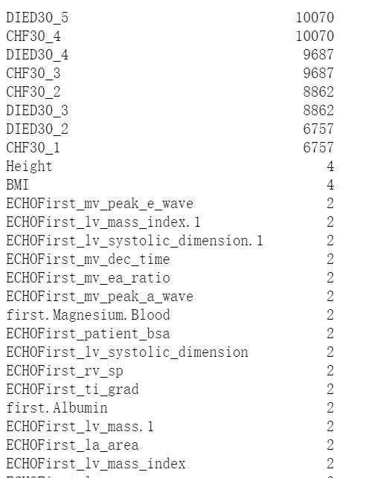
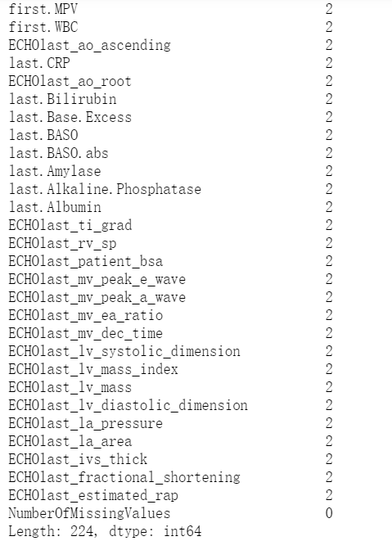
Data Ingestion-Data Missing(Space & NaN)
Count NaN values for all the features

Slide 5

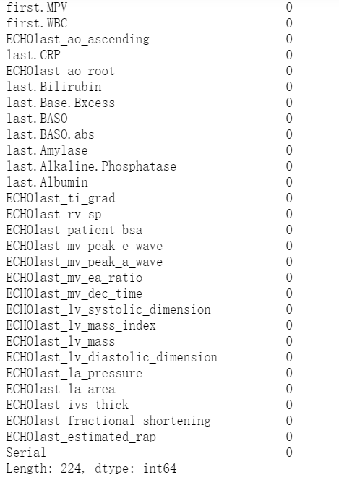
Data Ingestion-Data Missing(Space & NaN)
Drop the only two NaN rows-the last two rows

Slide 6
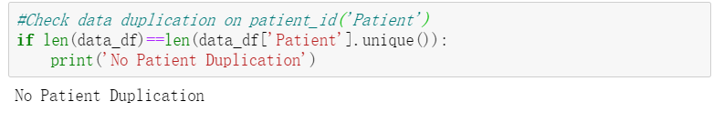
Data Ingestion-Data Duplication
Check data duplication on patient_id('Patient')

Slide 7
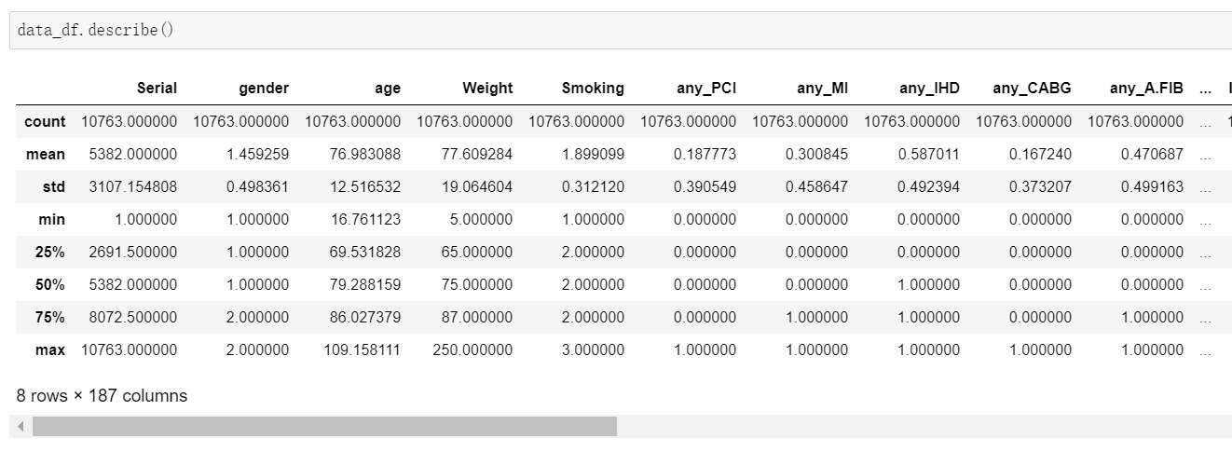
Descriptive Analysis-Continuous Data

Slide 8
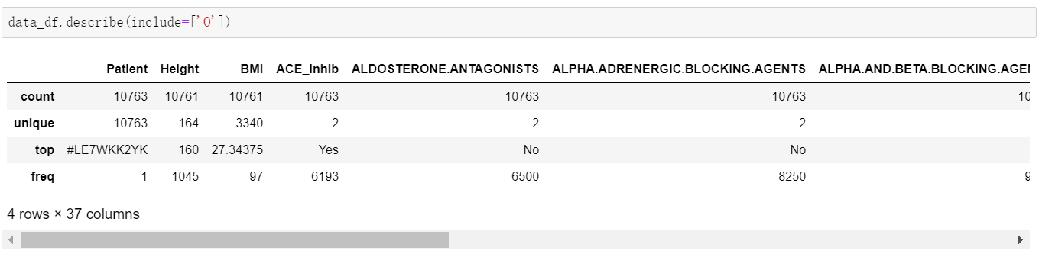
Descriptive Analysis-Discrete Data

Slide 9
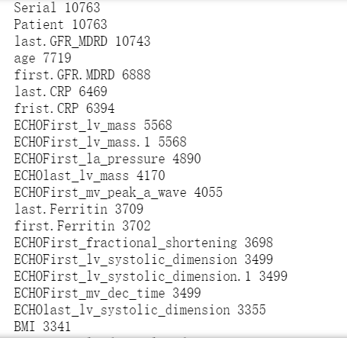
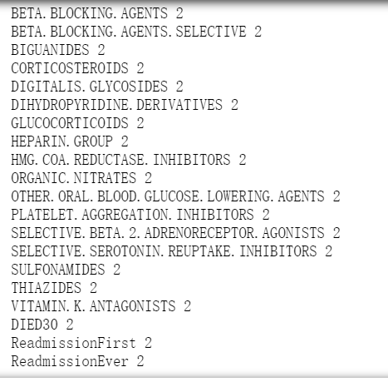
Descriptive Analysis-Variable Classification
Notice that the classification by DataFrame.describe() doesn’t work accurately for some features (object, etc)
Implement classification using the numbers of unique values for each of the features.

Slide 10
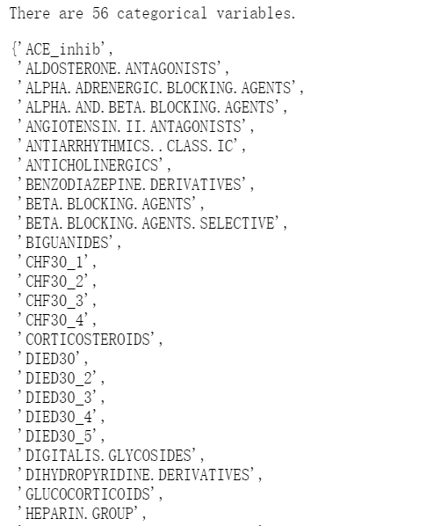
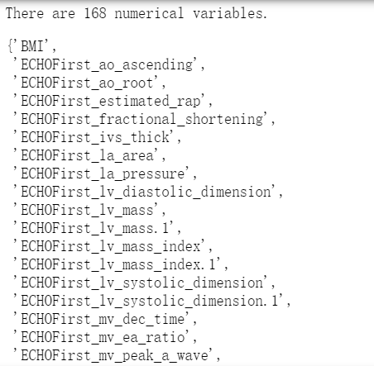
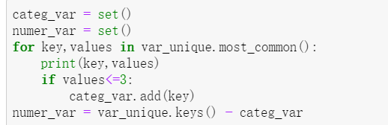
Descriptive Analysis-Variable Classification
Notice that the classification by DataFrame.describe() doesn’t work accurately for some features (object, etc)
Implement classification using the numbers of unique values for each of the features.

Slide 11
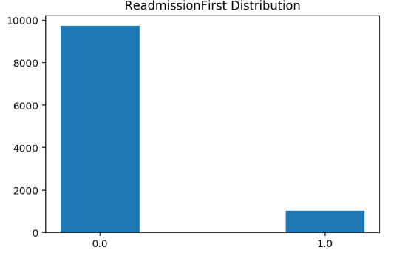
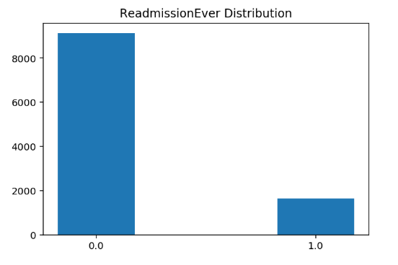


Data Visualization-Output Variable Distribution for Readmission

Slide 12
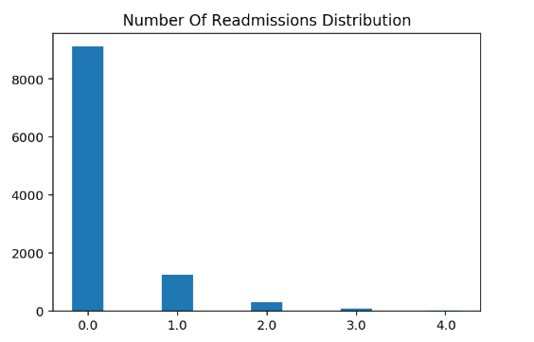
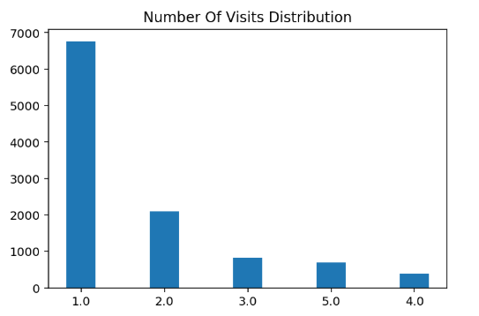
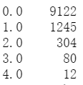
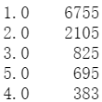
Data Visualization-Output Variable Distribution for Readmission

Slide 13
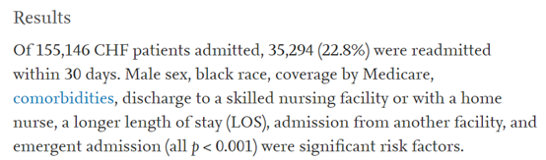
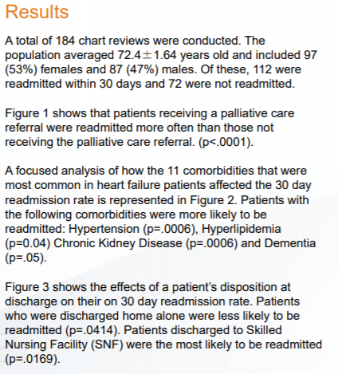
Data Visualization-Input Variable Distribution for Readmission
Risk factors for 30-day readmission in patients with congestive heart failure
-by Katelin A.MirkinMDaLaura M.EnomotoMDaGregory M.CaputoMD FACPbChristopher S.HollenbeakPhD
Risk Factors for Readmission in Patients with Heart Failure
-by Nancy Hart, BSN, RN, Ofelia Udarbe BSN, RN, PCCN, Mary Waldo PhD, RN, GCNS-BC

Slide 14
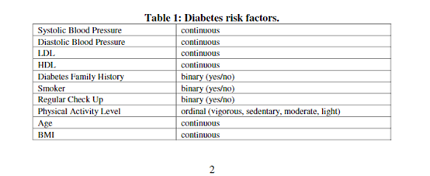
Data Visualization-Input Variable Distribution for Readmission
AN INFORMATION VISUALIZATION APPROACH TO CLASSIFICATION AND ASSESSMENT OF DIABETES RISK IN PRIMARY CARE
-by Christopher A. Harle Daniel B. Neill Rema Padman

Slide 15
Data Visualization-Input Variable Distribution for Readmission(First)
Age | continuous
BMI | continuous
Smoking | categorical(binary-yes/no)
first.Cholesterol.total | continuous
ECHOFirst_lv_systolic_dimension | continuous
ECHOFirst_lv_diastolic_dimension | continuous

Slide 16
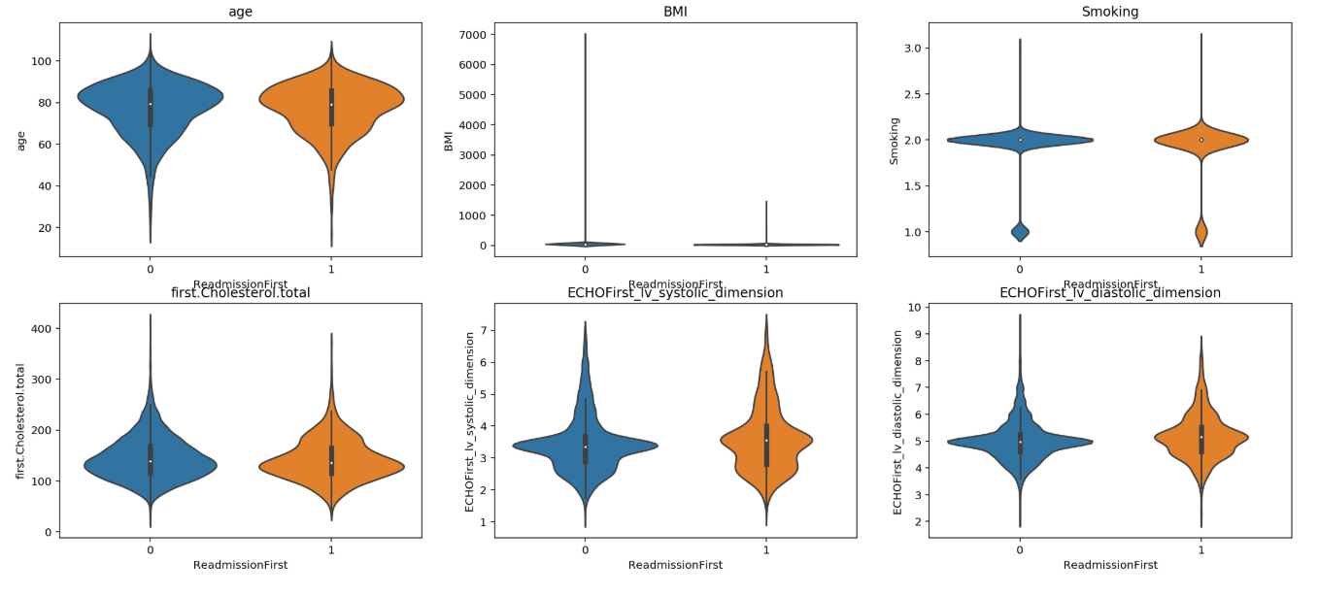
Data Visualization-Input Variable Distribution for Readmission(First)

Slide 17
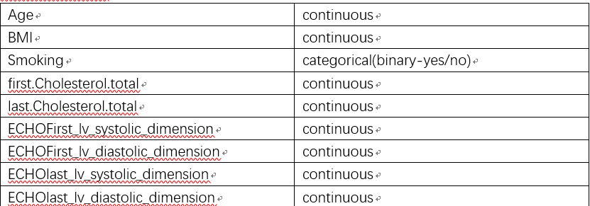
Data Visualization-Input Variable Distribution for Readmission(Ever)

Slide 18
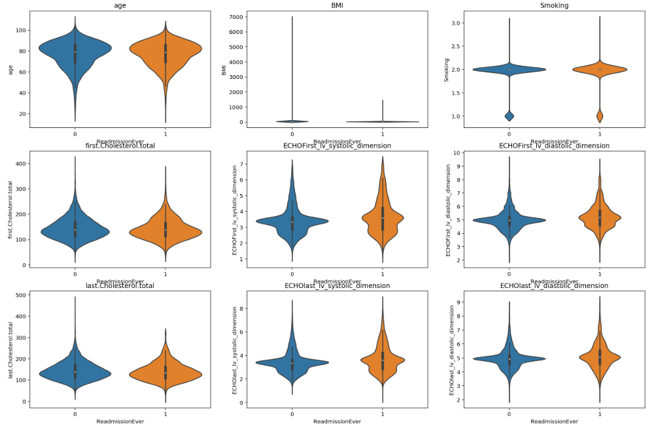
Data Visualization-Input Variable Distribution for Readmission(Ever)

Slide 19
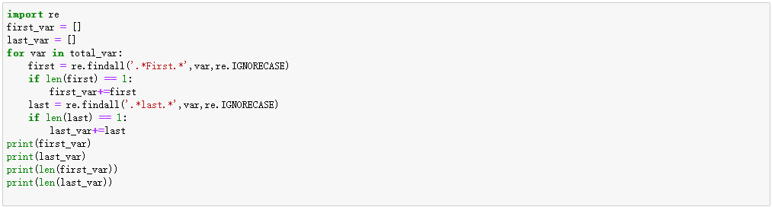
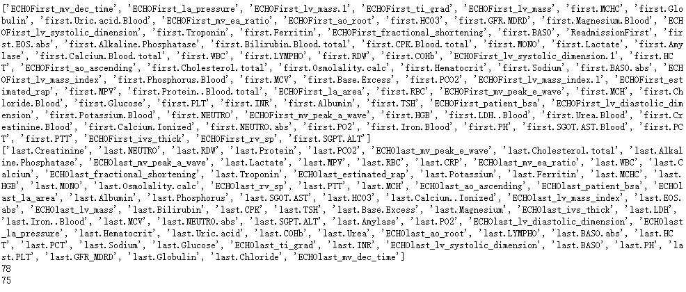
Data Visualization-Inter- Variable Correlation for Readmission

Slide 20
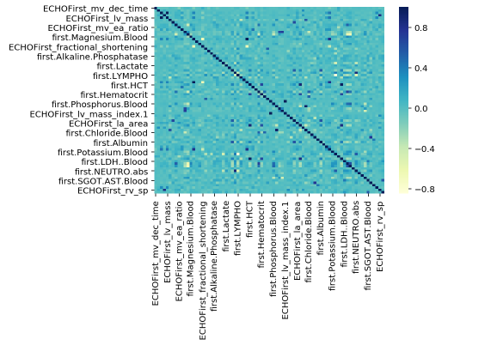
Data Visualization-Inter- Variable Correlation for Readmission

Slide 21
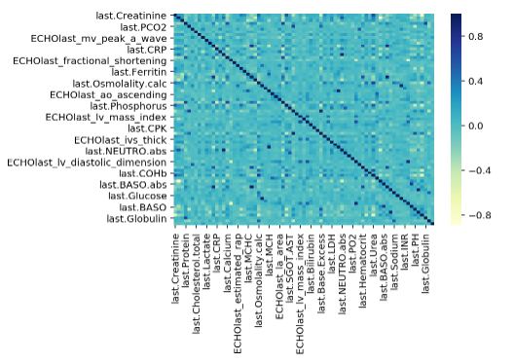
Data Visualization-Inter- Variable Correlation for Readmission

Slide 22
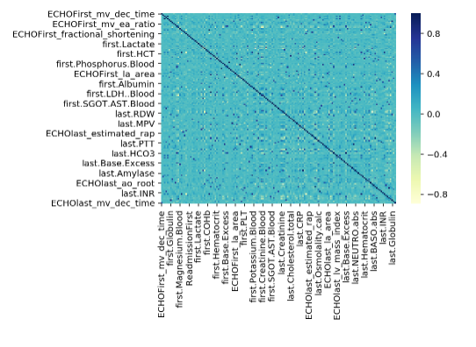
Data Visualization-Inter- Variable Correlation for Readmission

Slide 23
Further Plan
Learn more about the metrics and features for each patient recording
Literature review and research
Research further on the inter-variable correlation, especially focusing on the diagnosis data of first-visit and last-visit
Data visualization
Figure out the potential anchor features
Dimensionality reduction
PCA
(u2) KPCA: Kernel(ized) PCA (nonlinear, inductive),
(u3) MDS: Multi-Dimensional Scaling (nonlinear, transductive),
(u4) t-SNE: t-distributed Stochastic Neighbor Embedding (nonlinear, transductive),
(u5) Isomap: Isometric Mapping (nonlinear, transductive),
(u6) LLE: Locally-Linear Embedding (nonlinear, transductive)

